Slide 1
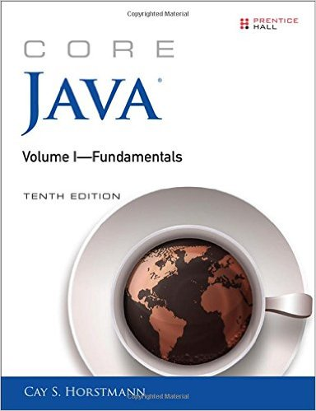
Ch 03: Fundamental Programming Structures in Java Part-one
Core Java, Volume I

Slide 2
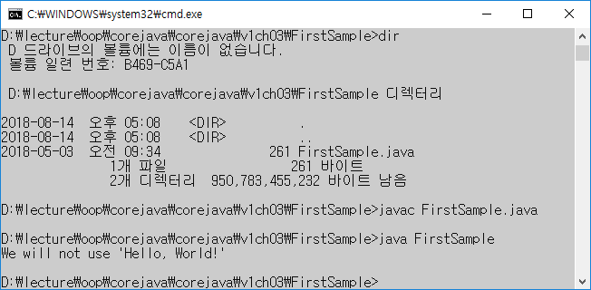
3.1. A Simple Java Program: prints message on console
Remarks: Java is case sensitive: e.g. Main ≠ main.
L1: The keyword “public” is an access modifier to control level of access by other classes( Ch5)
L1: The keyword “class”. In a java program, everything must be is inside a class container
L1: Name of class is FirstSample: By convention, class names are CamelCase.
We when we save, the file name of the source code must be the same as the class name with the extension .java (e.g. FirstSample.java)
1. public class FirstSample
2. {
3. public static void main(String[] args)
4. {
5. System.out.println( “ Hello, World! “ );
6. }
7. }
Output: Hello, World!

Slide 3
3.1. A Simple Java Program: prints message on console
To run the program, run the following two commands
A) Run “javac” command to compile the source and to generate byte code as follows.
javac <FileName of SourceCode.java>
example: javac FirstSample.java
Note: the java compiler automatically name the byte code file as
“FirstSample.class” and stores in the same folder of the source code
B) Run “java” command to run the program as follows
java< FileName of byte code>
example: java FirstSample
Line 3: we run the command “java Class name”, JVM starts execution
from the main() method of the class.
Line 3 : we will study “static” key word in chapter 4

Slide 4
Method Calls
Note: “System.out” is an object and its calls its method “println().
Java uses the following general syntax to call a method.
The number of parameters can be zero, one ,two etc.
Parentheses needed even if there are no parameters:
Example: System.out.println(); // display blank line
Note: System.out object has print() method that does not add new line to output.
Line 5: System.out.println("We will not use 'Hello, World!'"); // output
object.method (parameters);

Slide 5
3.2 Comments.
Comment lines are not executed. Java has 3 ways to mark commnets.
a) Single-line comments:
b) Multi-line comments:
c) Documentation comments to generate documents automatically:
Caution: do not nest comments in java
// like this
/*
like
this
...
*/
/**
* This is the first sample program in Core Java Chapter 3
* @version 1.01 1997-03-22
* @author Gary Cornell
*/

Slide 6
3.3. Data Types
Java is a strongly typed language.
Hence, every variable must have a declared type
There are eight primitive types in Java.
6 Numeric types
4 Integral types: int, short, long, byte
2 Floating-point types: float, double
Character type : char type for Unicode system
Boolean type : Boolean type for truth values
Note: Java has does not have any unsigned type
Java has a string type String
It is not a primitive type, but a class defined in the library.

Slide 7
Numeric Data Types
3.3.1 Four integer types
Literals:
Long: 4000000000L and L is suffix long integer numbers
Hex: 0xCAFE and the prix “ox” is for hexadecimal numbers
Binary: 0b1111_0100_0010_0100_0000 and the prefix ob is to write numbers in binary
3.3.2. Two floating-point types:
float literals: 0.5F and F is suffix to show float and otherwise it is double by default
3 Special floating-point values: Double.POSITIVE_INFINITY, Double.NEGATIVE_INFINITY, Double.NaN.
int | 4 bytes | –2,147,483,648 to 2,147,483, 647 (just over 2 billion)
short | 2 bytes | –32,768 to 32,767
long | 8 bytes | –9,223,372,036,854,775,808 to 9,223,372,036,854,775,807
byte | 1 byte | –128 to 127
float | 4 bytes | Approximately ±3.40282347E+38F (6–7 significant decimal digits)
double | 8 bytes | Approximately ±1.79769313486231570E+308 (15 significant decimal digits)

Slide 8
3.3.3 The char Type
Char type describes Code Units in the UTF-16 encoding.
A code point is a code value that is associated with a character in an encoding system
In the Unicode standard, code points are written in hexadecimal with prefix U+
In UTF-16, every Unicode character requires one or two code units:
The UTF-16 encoding represents all Unicode code points in a variable length code
Example 1: Letter A : U+0041 is code point in Unicode (hex 0041,decimal 65).
Example 2: chatacter ‘𝕆’ has “code point” U+1D546.
It is encoded by two code units with hex values u+D835 and u+DD46.
Note 1: in java, the char type describes a code unit in the UTF-16 Encoding
Note 2: Avoid char type in your program unless you are manipulating UTF-16 code units.

Slide 9
3.3.4. The boolean Type
Boolean type has two values: false or true.
No conversion between int type and Boolean type .
Note : In C & C++, numbers and even pointers can be used in place of boolean values
Assume that X is boolean variable;
Case 1: if ( x = 0 ); // compile , run and return false in C++ because
a) the value 0 is equivalent the bool value false
b) non-zero value is equivalent to true
c) Hence, numbers can be used inplace of Boolean values.
Case 2: if ( x = 0 ) // compile error in Java because the integer x=0 cannot be converted to a boolean value

Slide 10
3.4. Declaration of Variables
In java, every variable must be declared with a type, which comes before the name.
Syntax: <data type> < varaible name>;
Declaration can appear anywhere in block.
Examples:
double saraly=20;
bolean Isdone=false;
int a,b;
3.4.1. Initialization of variables.
Example 1:
int vacationDays;
System.out.println(vacationDays ); // error because the varaible should be initialized before it is used.
Example 2:
int vacationDays= 10;
System.out.println(vacationDays ); // the program runs

Slide 11
3.4. 2 Declaration of Constants
Q1: How to a local constant to one method of a class ?
In java, use the “final” keyword to declare constant
pubic class ConstantOne
{
public static void main(String[] args)
{
final double CM_PER_INCH = 2.54; // convention: CAPITAL LETTERs
…
}
}

Slide 12
3.4. 2 Declaration of Constants
Example 2: How to a class level constant (Global to all methods of a class) ?
In java, use the “static final” keyword to declare constant
pubic class ConstantTwo
{
public static final double CM_PER_INCH = 2.54;
public static void main(String[] args)
{
…
}
}

Slide 13
3.5. Operators
a) Usual arithmetic operators:
+, - , * , / and %
b) Prefix and postfix Increment and
decrement operators on variables :
++ Expression;
-- expression;
expression++;
Expression -- ;
c) Relational Operators:
expression1 == expression 2;
expression1 != expression2;
expression1 < expression2,
expression1 <= expression2
d) logical(Boolean) operators:
expression1 && expression1
expression1 && expression1
! Expression1
e) Ternary operator( ? : )
syntax: condition ? expression1 : expression2
f) Bitwise operator
Bitpattern1 & Bitpattern1
Bitpattern1 | Bitpattern1
Bitpattern1 ^ Bitpattern1
~Bitpattern1

Slide 14
3.5.4. Mathematical Functions and Constants
The java.lang.Math contains many mathematical functions.
Trigonometric functions :
Math.sin(),
Math.cos(),
Math.tan, atan(),
Math.toRadians(),
Math.toDegrees(), …
b) Exponential and logarithm functions :
Math.exp(),
Math.log(),
Math.log10()
c) Manipulating values :
Math.abs(),
Math.round(), …
d) Maximum and minimum values :
Math.max(),
Math.min()
Math. sqrt()
Math.random() …
e) The Math class constants
Math.PI // π
Math.E // e
f) How to use them
Example:
double x=4;
double y=Math.sqrt(x);
System.out.println(y);
Question: what is the difference between
Math.sqrt(x) call and System.out.println(y) call?
Answer: Static method Versus dynamic method (ch4)

Slide 15
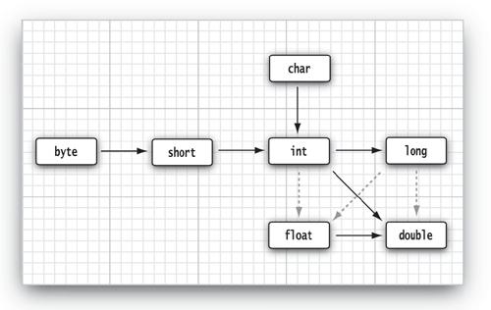
3.5.5. Conversion between Numeric Types and Casting
Automatic type conversion (widening)
Use casts for explicit casting conversions:
double x = 9.997;
int nx = (int) x ; // now nx is 9 and there is no automatic conversion;
int rx = (int) Math.round(x); // now rx is 10 and terre is no automatic conversion;
Note: Math.round(x) and return long data type ;
Note:
“dotted arrows indicate possible precision loss”
Solid arrows indicate no loss of precision

Slide 16
3.5.8. Enumerated data Type
When we need to assign a restricted set of nominal values
using “enum” key word.
Assume the size of a cloth is small, medium, large & extra large
Syntax: enum<NameofEnumration> { nominal1,nominal2..} ;
Step 1: Declare enumeration Type;
enum Size { SMALL, MEDIUM, LARGE, LARGE_EXTRA } ;
Step 2: we can declare variables of this enumeration type
Size s=Size.Medium;
In Ch 5, we will study enumerated data Type in detail.

Slide 17
3.6 Strings and substrings
Java does not have a built-in string type;
However, the standard java library contains a predefined call called” String”.
See java.lange. String from Java API
Java string is a sequence of Unicode characters.
Example: String literals enclosed in double quotes:
Example: "Java\u2122 ". This string contains 5 Unicode characters J, a, v ,a and TM trade mark
Hence, each quoted string is an instance of the String class.
String e = “ ” ; // empty string
String greeting = “Hello”;

Slide 18
3.6.1 Substrings
We can extract a substring from a larger string using the “substring” method of “String” class
Example:
String greeting = "Hello";
String s = greeting.substring(0, 3);
Now variable s consists of “Hel”;
Positions start at zero and end at length-1;
Last position is excluded
s. substring(a, b) has length b – a.
Hence ,the length of s is 3-0=3 :

Slide 19
3.6.2. Concatenating Strings
Concatenation operator (+) joins two strings:
String expletive = "Expletive";
String PG13 = "deleted";
String message = expletive + PG13; // message=“Expletivedeleted”
If one operand is not a string, it is turned into a string:
int age = 13;
String rating = "PG" + age; // rating=“PG13”
System.out.println(“ The age is “ + age ); // The age is 13.

Slide 20
3.6.3. Strings are Immutable
“String” class has no method to change a character in an existing string
Objects of the “String” class are immutable.
Example:
String greeting = "Hello";
greeting = greeting.substring(0, 3) + p! ; // greeting=“ Help! ”
Two understand immutability of string objects, we have to consider two memory areas for a given java application namely
a) stack memory area of the application
b) heap memory area of the application
We have to also understand the difference between reference variable on stack memory and object of a class on a heap memory

Slide 21
3.6.3. Strings are Immutable
Modifying a string variable
String greeting = “Hello”;
// note: greeting is variable on stack and Hello is an object on heap
greeting = greeting.substring(0,3)+ ”p! ” ;
does not change the “hello” string,
Copying a string variable
String hi = greeting;
“Hello”
“Help!”
greeting
greeting
“Hello”
greeting
“Hello”
hi

Slide 22
3.6.3. Testing Strings for Equality
The expression StringOne.equals(StringTwo) returns true if both are equal.
Example:
String greeting = "Hello";
"Hello". equals(greeting); // output is true;
“hello".equalsIgnoreCase(greeting) // ignoring the case
Caution: Do not use the == operator to compare two strings.
"Hello".substring(0, 3) == "Hel" // probably false
Empty string versus null string
empty string “ " has length 0 and is different from null string
Example 1: if (str.equals(“ “); // returns true if reference variable str is empty string
Example 2: if (str.length==0); // returns true if reference variable str is empty string
Example 3: if (str==null; // returns true if the reference variable str is null string
Note : empty string is java object on heap area .However, null is a special value so that there is no object on heap which corresponds to the string reference variable on stack area.

